Slide 1
Solving Graph Isomorphism with Minimum Bit Strings
Josh Krcadinac
Rafael Lastiri

Slide 2
Overview
What is Graph Isomorphism
Applications
Bit String Background
Our Contribution
Results

Slide 3
What is Graph Isomorphism
Two graphs are isomorphic if we can find a permutation of the set of edges and vertices of one graph that map to the edges and vertices of the second graph
Requires same number of vertices, edges, vertex degrees and graph structure

Slide 4
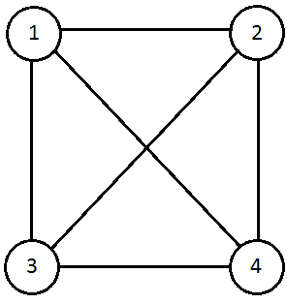
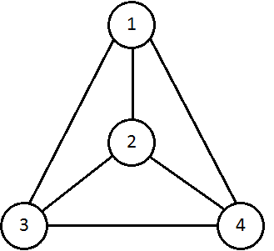
Graph 1
Graph 2

Slide 5
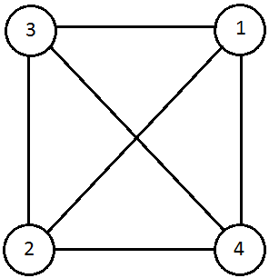
Graph 2 can map onto Graph 1

